Slide 2
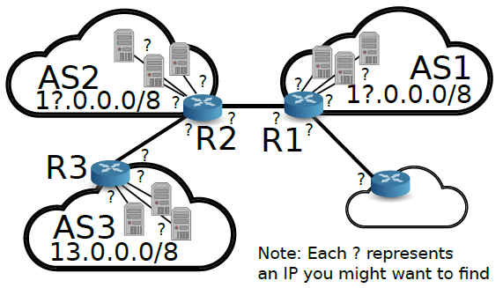
1
2

Slide 3
12.0.1.1
11.0.3.1
11.0.2.1
12.0.2.1
12.0.1.254
11.0.3.254
11.0.2.254
11.0.1.1
12.0.2.254
12.0.3.1
R2
R1
AS2
12.0.0.0/8
12.0.3.254
9.0.0.2
9.0.0.1
11.0.1.254
AS1
11.0.0.0/8
9.0.1.1
9.0.4.1
9.0.1.2
R3
13.0.1.254
13.0.3.254
13.0.2.254
13.0.1.1
13.0.3.1
13.0.2.1
AS3
13.0.0.0/8

